Slide 1
Effective Language and Communication Skills (Course Code: HS1000)
Instructor: Dr. Kandharaja K M C

Slide 2
Course plan
Read the course plan.

Slide 3
Join the google classroom
Google classroom code for B4 batch: xns2udv

Slide 4
Join the google classroom
Google classroom code for B1 batch:
3ebazwt

Slide 5
Class timings (B4 batch)
Tuesday: 10 am to 10.50 am
Friday: 8 am to 9.50 am

Slide 6
Class timings (B1 batch)
Tuesday: 8 am to 8.50 am
Thursday: 1 pm to 2.50 pm

Slide 7
Brainstorming
Why every human being has to attend primary school?

Slide 8
Read the article:
The World’s Oldest First Grader

Slide 9
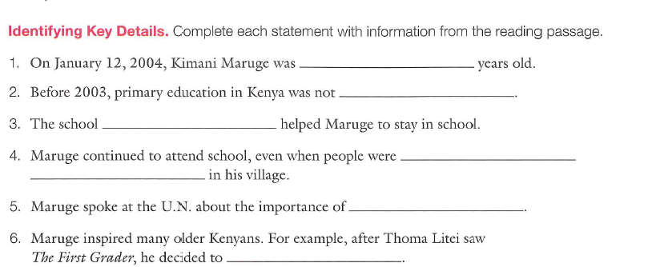

Slide 10
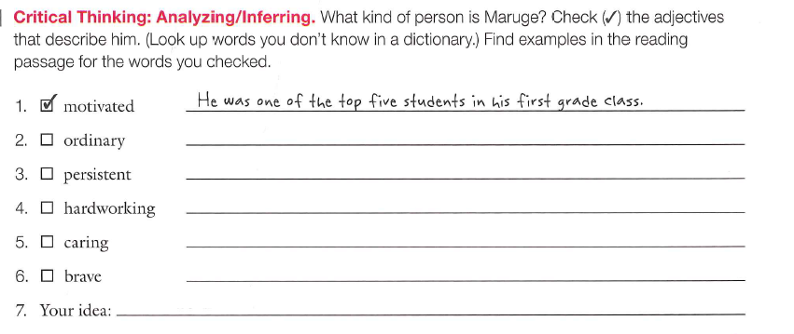

Slide 11
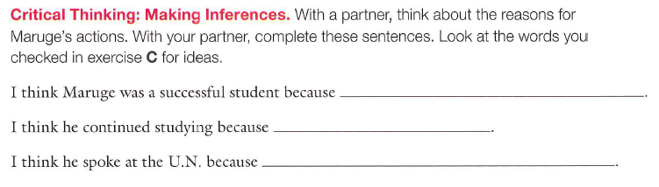

Slide 12
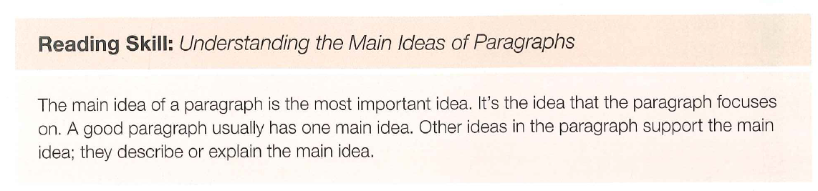

Slide 13
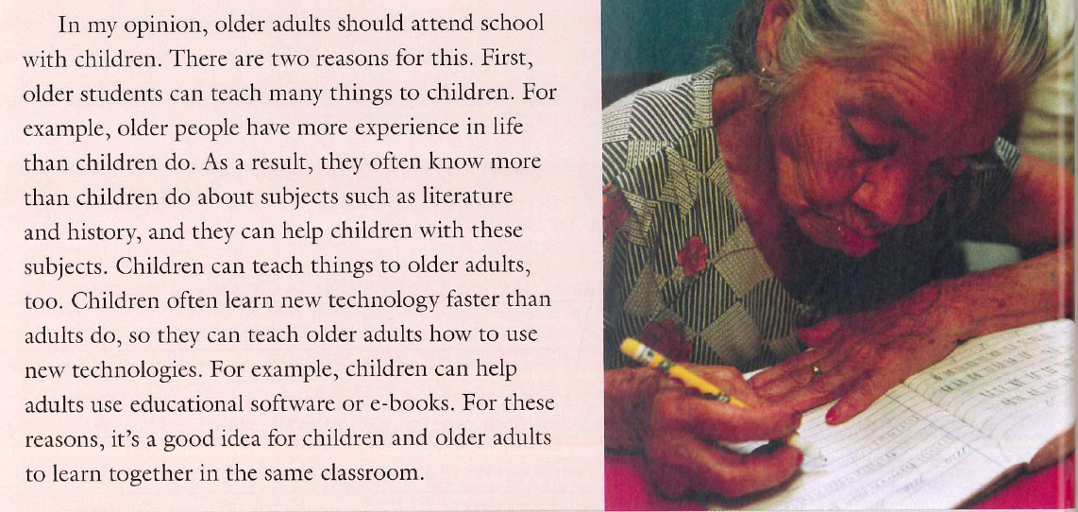

Slide 14
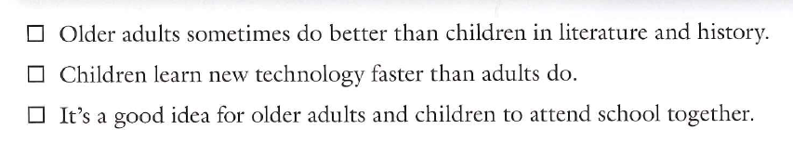

Slide 15
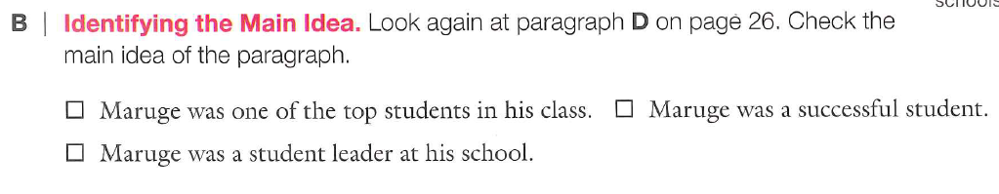

Slide 16
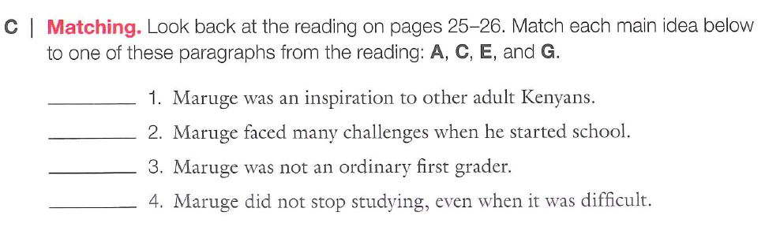

Slide 17
Reading the article
The Battle Against Malaria

Slide 18
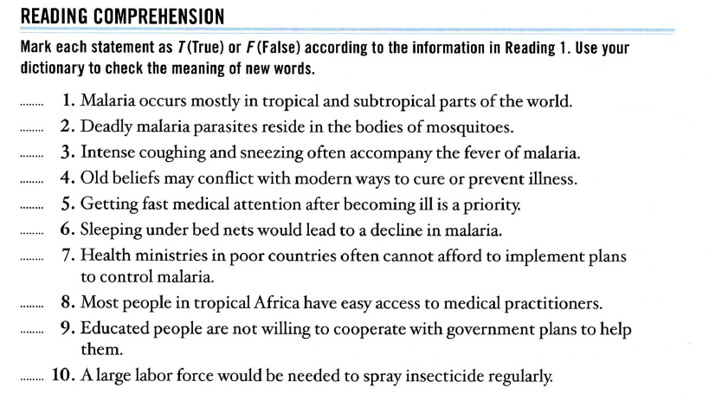

Slide 19
Do the vocabulary activity
Complete the story

Slide 20
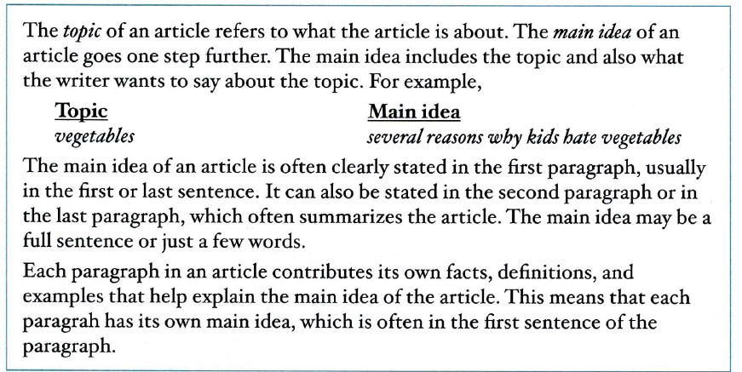

Slide 21
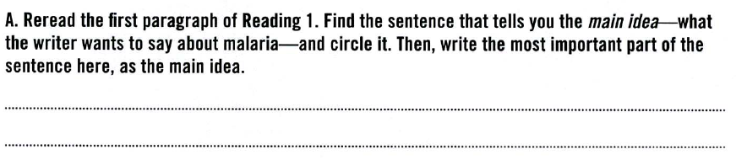

Slide 22
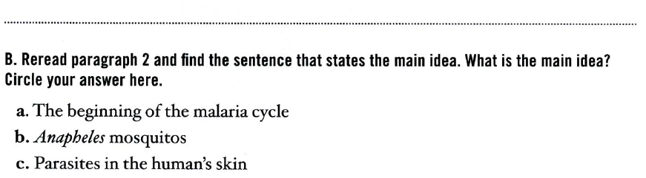

Slide 23
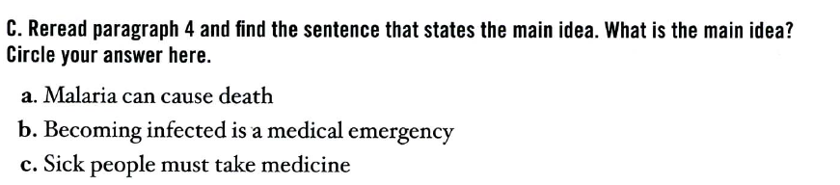

Slide 24
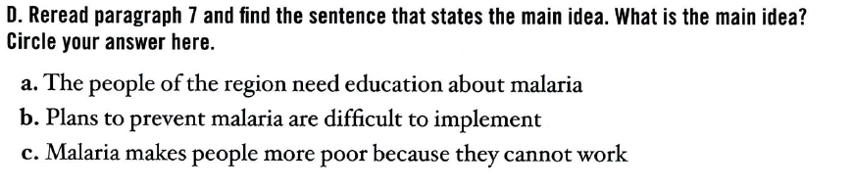

Slide 25
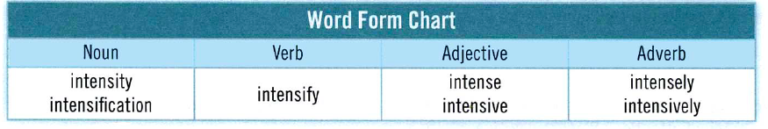

Slide 26
